Slide 1


Slide 2
Students will be able to explain the Law of Conservation of Mass
TRACK WITH ME
READ WITH ME
Define the Law of Conservation of Mass
Understand that the number of atoms never change within a reaction.
Calculate the mass of products, given the mass of the reactants.
DECLARE THE OBJECTIVE
Read the learning objective to your partner.
Notes:
Learning Objectives contain concepts (nouns, big ideas), skills (verbs, measurable behaviours) and sometimes context (restricting or targeting conditions).
●Example: Students will be able to describe the concept of density and apply it to floating and sinking.
●
Success criteria are specific measurable outcomes that if met mean that the student has met the learning objective.
Examples:
•Students will be able to compare densities of substances using mass and volume.
•Students will be able to identify whether a solid or liquid will float or sink in a liquid based on their densities.

Slide 3
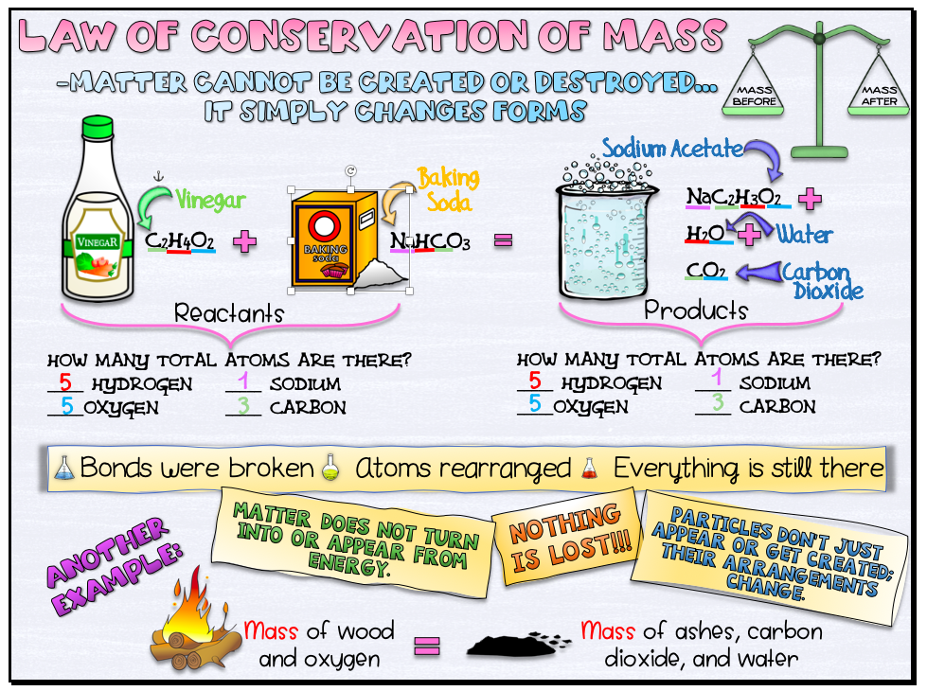

Slide 4
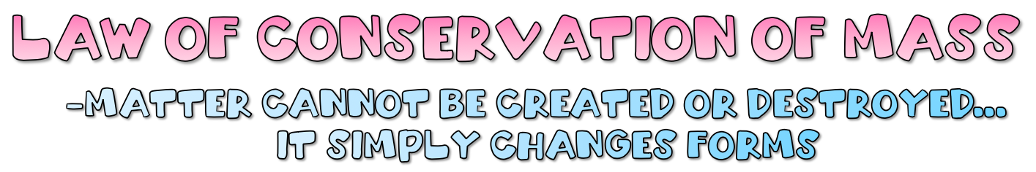
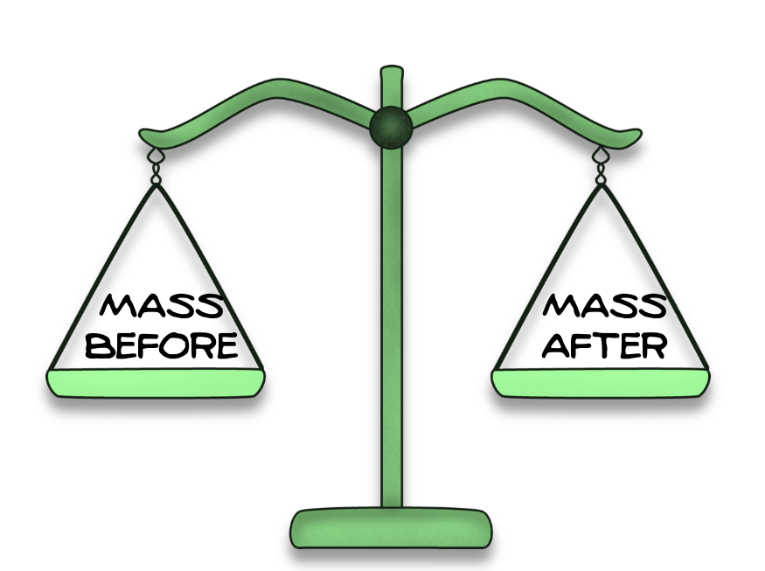

Slide 5
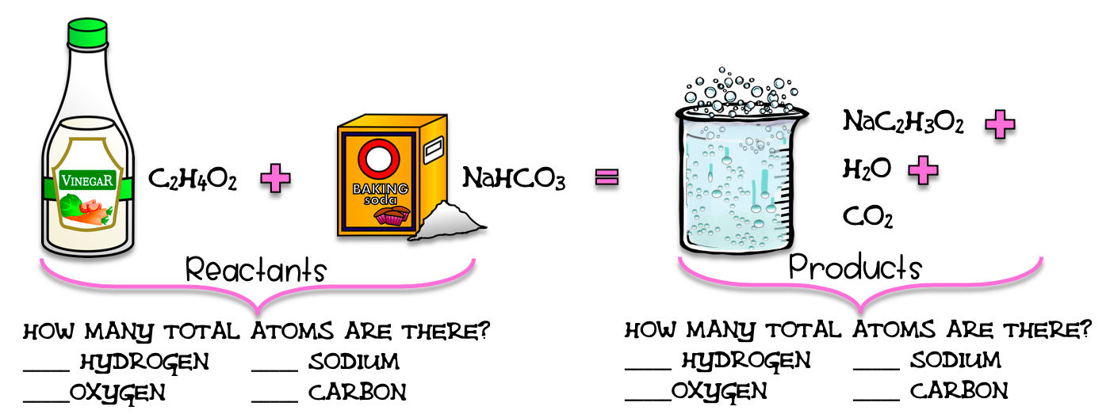

Slide 6
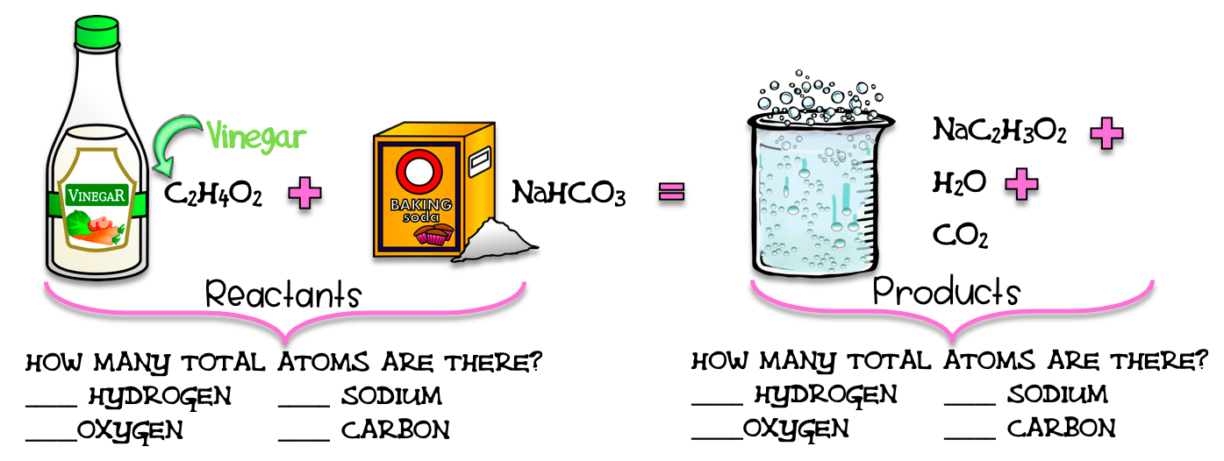

Slide 7
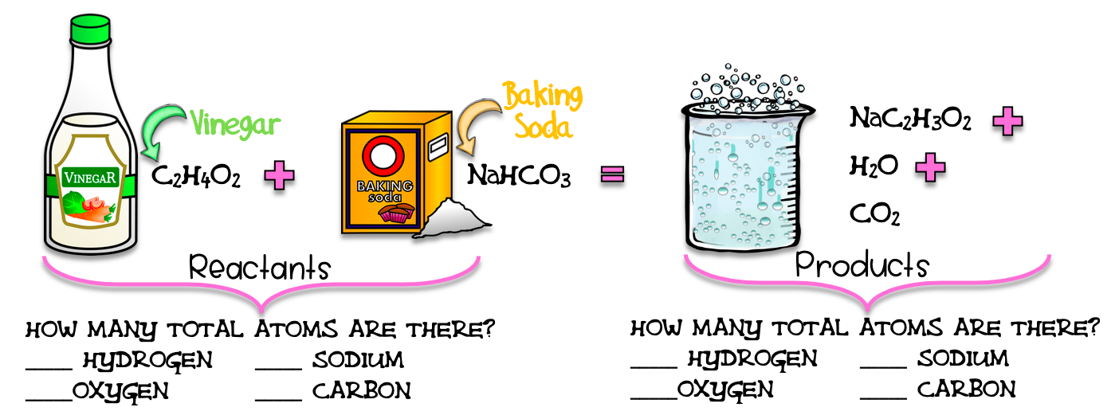

Slide 8

Directions: Underline the hydrogen in the reactants in red.

Slide 9
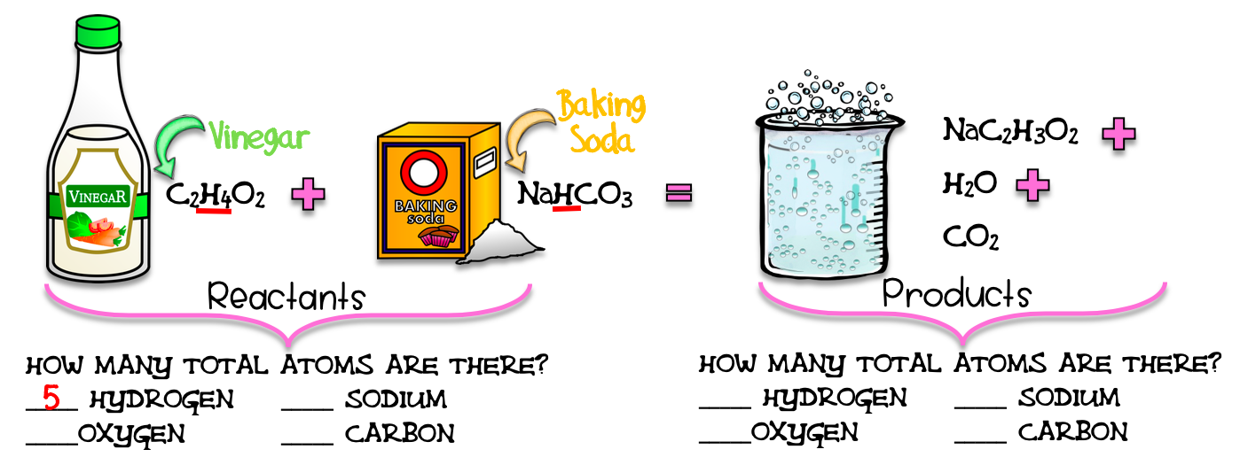
Directions: Count them and record.

Slide 10


Directions: Underline the oxygen in the reactants in blue.

Slide 11

Directions: Count them and record.

Slide 12

Directions: Underline the sodium in the reactants in purple.

Slide 13

Directions: Count them and record.

Slide 14
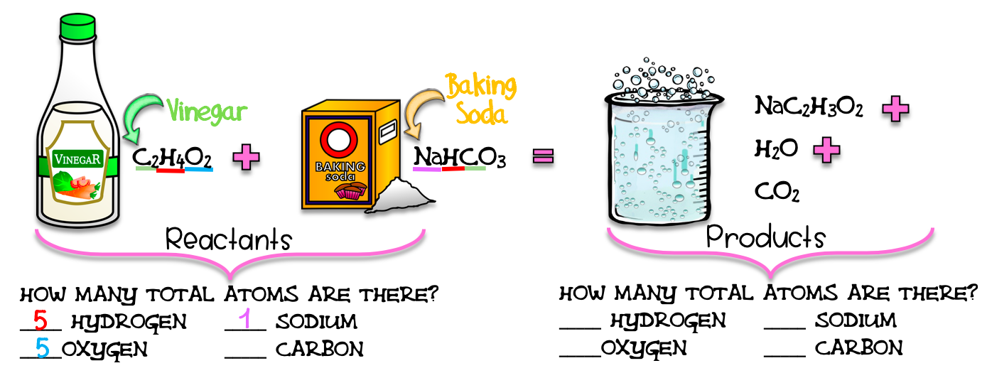
Directions: Underline the carbon in the reactants in green.

Slide 15

Directions: Count them and record.

Slide 16
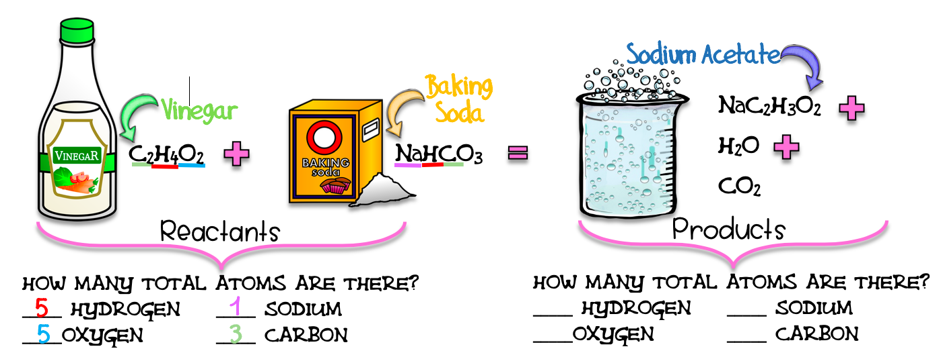

Slide 17
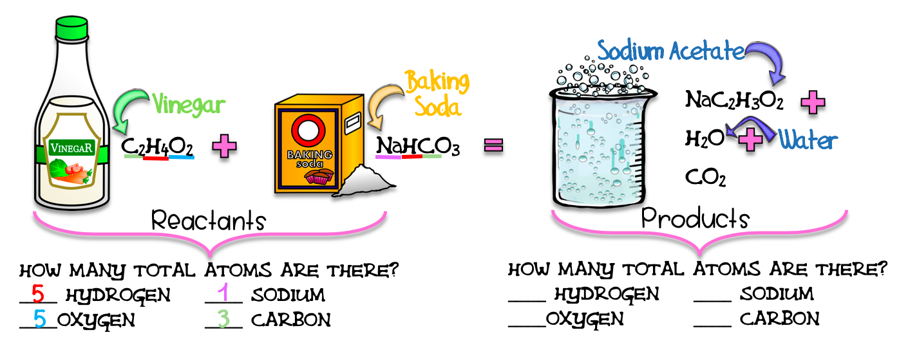

Slide 18
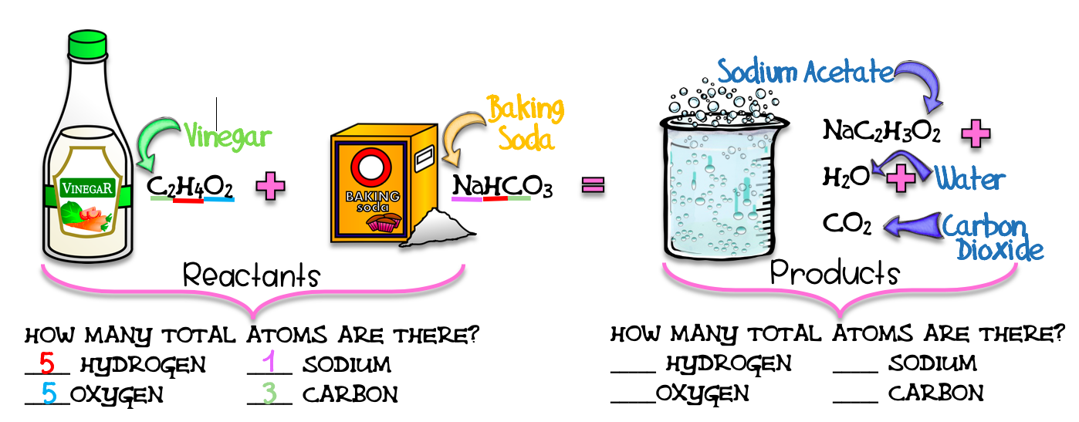

Slide 19
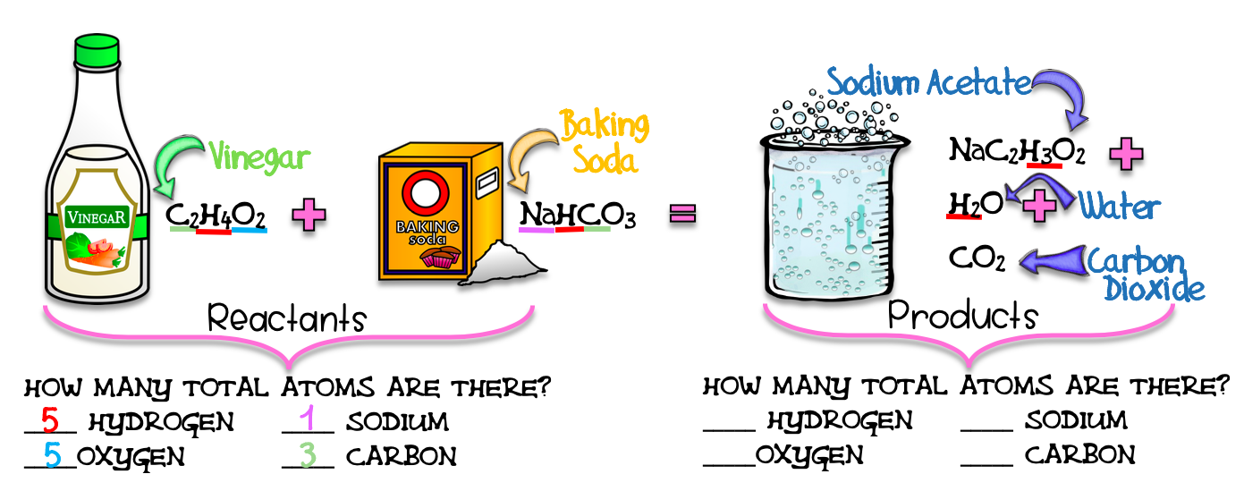
Directions: Underline the hydrogen in the products in red.

Slide 20
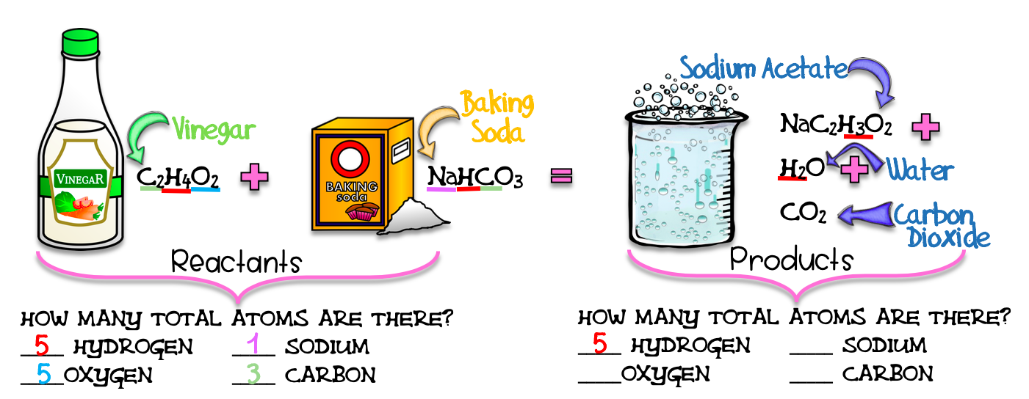
Directions: Count them and record.

Slide 21
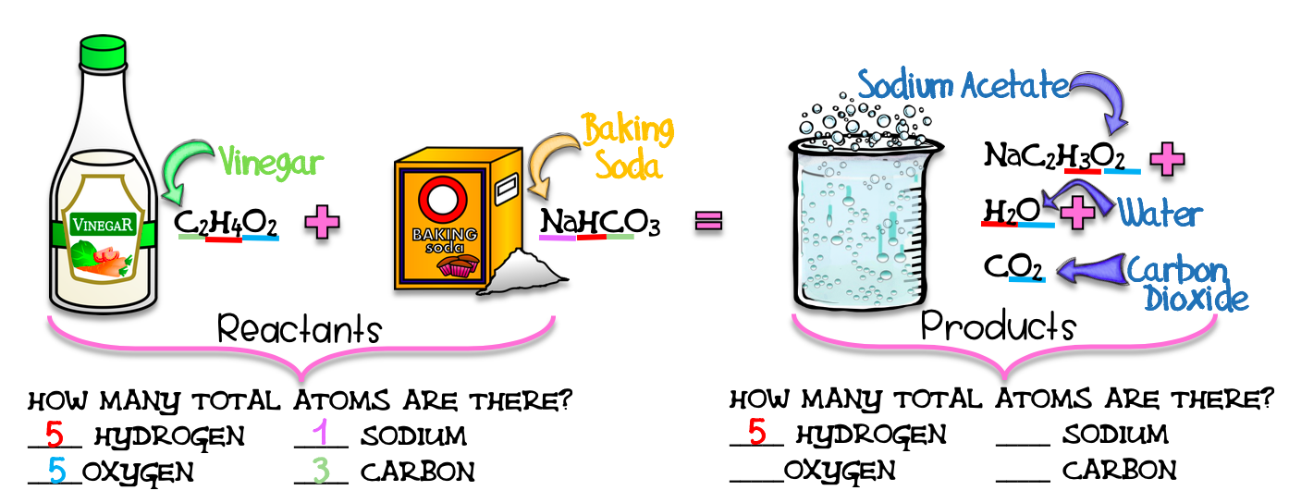
Directions: Underline the oxygen in the products in blue.

Slide 22
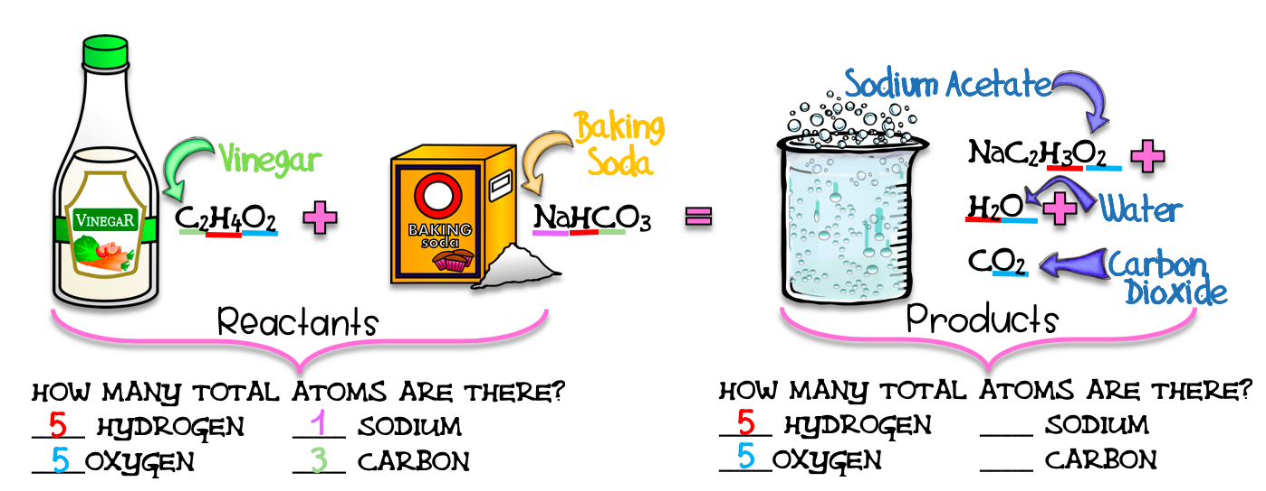
Directions: Count them and record.

Slide 23
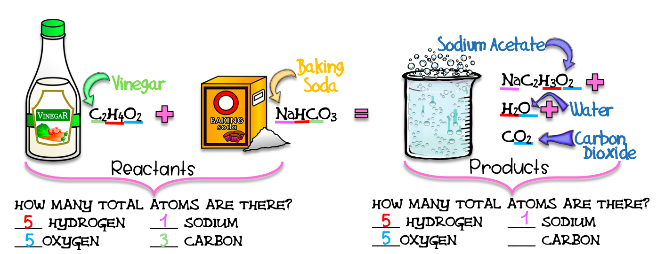
Directions: Underline the sodium in the products in purple.

Slide 24
Directions: Count them and record.

Slide 25

Directions: Underline the carbon in the products in green.

Slide 26

Directions: Count them and record.

Slide 27


Slide 28


Slide 29


Slide 30




Slide 31



Slide 32



Slide 33


Slide 34
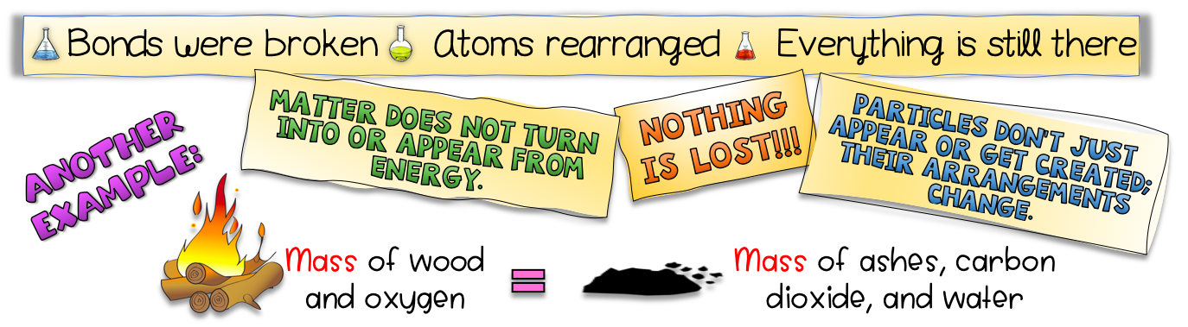

Slide 36
Credits and Copyright
Black-Eyed Susan Science
Next Generation Science Standards
Kimberly Geswein Fonts
https://images.app.goo.gl/mh1EHhmhR6ekQAte9
KB3Teach
The 3am Teacher
The Cher Room
The Painted Crow
Sarah Pecorino Illustration
Teachers Resource Force

